Slide 1
Chapter 13
Chemical Equilibrium

Slide 2
13.1 The Equilibrium Condition
13.2 The Equilibrium Constant
13.3 Equilibrium Expressions Involving Pressures
13.4 Heterogeneous Equilibria
13.5 Applications of the Equilibrium Constant
13.6 Solving Equilibrium Problems
13.7 Le Châtelier’s Principle

Slide 3
Chemical Equilibrium
The state where the concentrations of all reactants and products remain constant with time.
On the molecular level, there is frantic activity. Equilibrium is not static, but is a highly dynamic situation.
Concentrations reach levels where the rate of the forward reaction equals the rate of the reverse reaction.

Slide 4
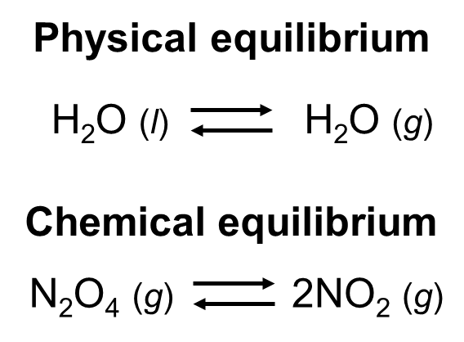
Equilibrium: the extent of a reaction
In stoichiometry we talk about theoretical yields, and the many reasons actual yields may be lower.
Actual yields may be lower is the reversibility of chemical reactions: some reactions may produce only 70% of the product you expect
Equilibrium looks at the extent of a chemical reaction.

Slide 5
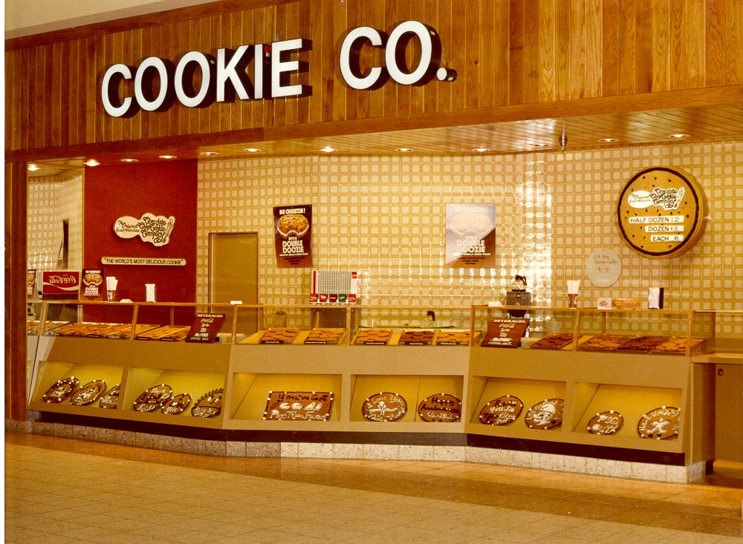
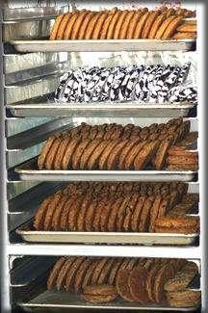
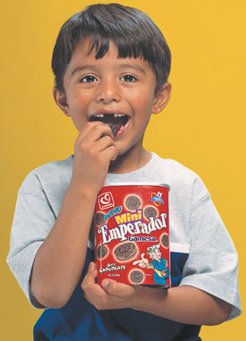

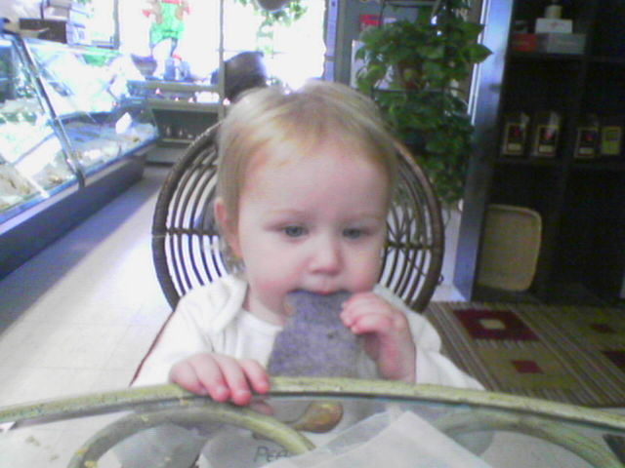
Rate of sale of cookies
=
Rate of replacing cookies

Slide 6
The Concept of Equilibrium
As the reaction progresses
  [A] decreases to a constant,
  [B] increases from zero to a constant.
  When [A] and [B] are constant, equilibrium is achieved.

Slide 7
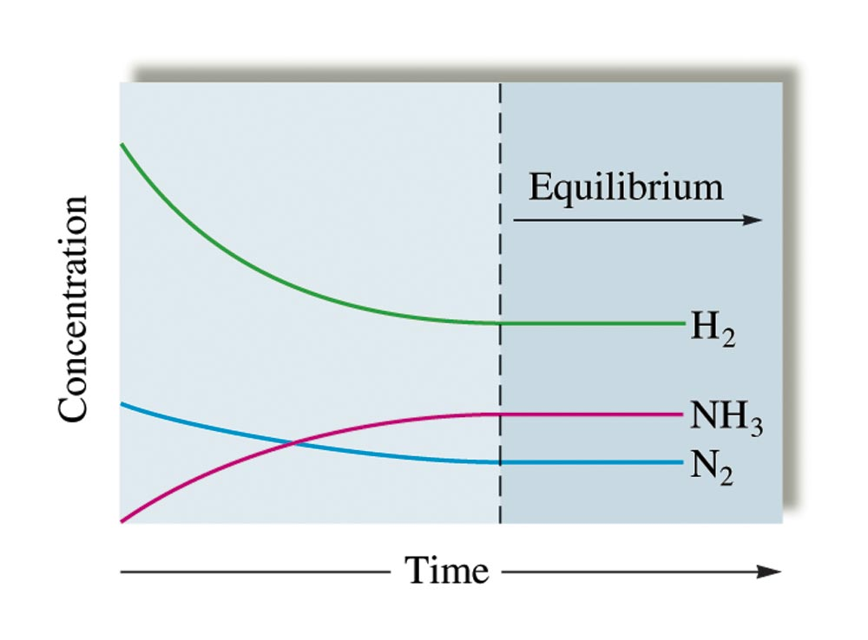
Changes in Concentration
N₂(g) + 3H₂(g) 2NH₃(g)

Slide 8
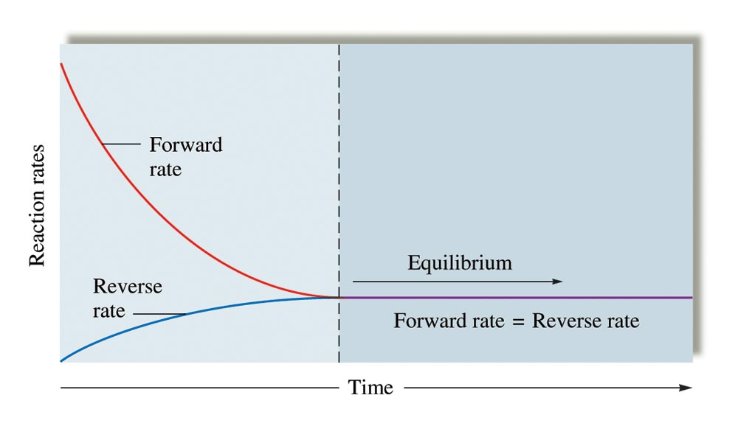
The Changes with Time in the Rates of Forward and Reverse Reactions

Slide 9
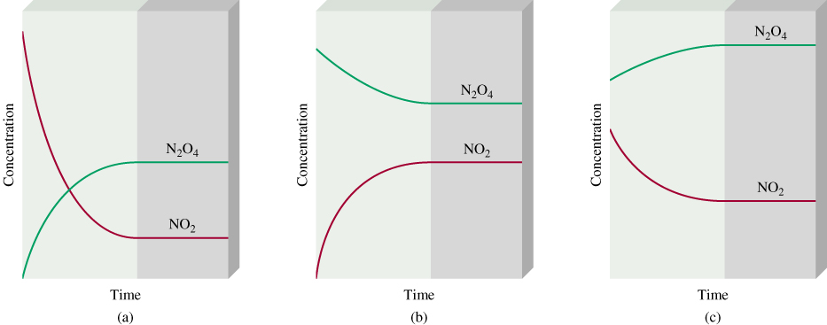
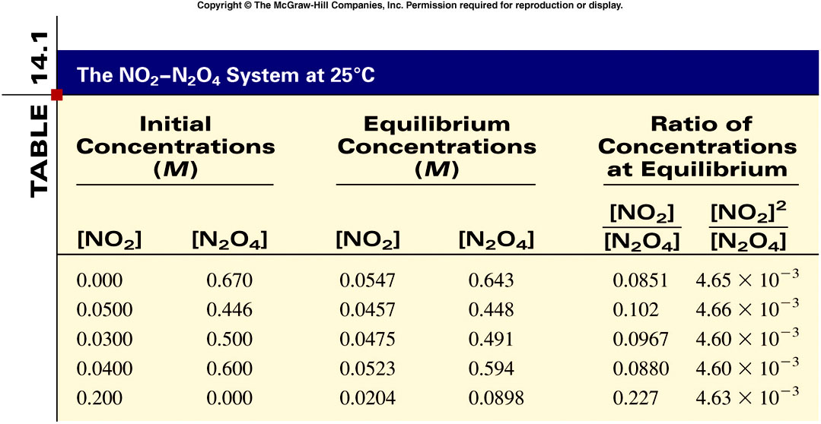
constant
14.1

Slide 10
Consider the following reaction at equilibrium:
jA + kB lC + mD
A, B, C, and D = chemical species.
Square brackets = concentrations of species at equilibrium.
j, k, l, and m = coefficients in the balanced equation.
K = equilibrium constant (given without units).
[C]
l
[D]
m
K
=
[A]
j
[B]
k

Slide 11
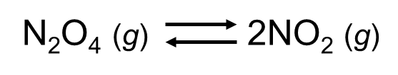
The Equilibrium Expression
Write the equilibrium expression for the following reaction:

Slide 12
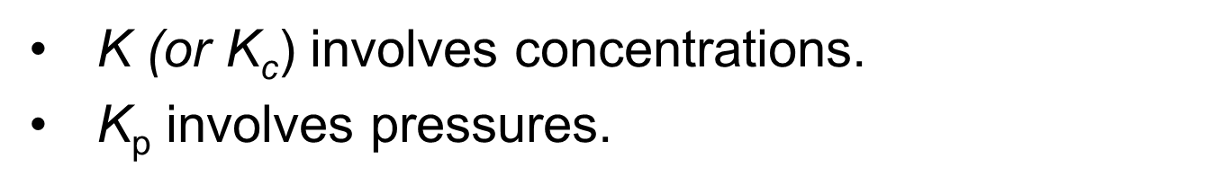
Example
N₂(g) + 3H₂(g) 2NH₃(g)

Slide 13
Conclusions About the Equilibrium Expression
For the reverse reaction, the equilibrium expression is the reciprocal (products become reactants, and reactants become products in a reverse reaction)
K values are usually written without units.

Slide 14
K always has the same value at a given temperature regardless of the amounts of reactants or products that are present initially.
For a reaction, at a given temperature, there are many equilibrium positions but only one value for K.
  Equilibrium position is a set of equilibrium concentrations.

Slide 15
Example
N₂(g) + 3H₂(g) 2NH₃(g)
Equilibrium pressures at a certain temperature:

Slide 16
Example
N₂(g) + 3H₂(g) 2NH₃(g)

Slide 17
The Relationship Between K and K_{p}
K_{p} = K(RT)^{Δn}
Δn = change in moles of gas
R = 0.08206 L·atm/mol·K
T = temperature (in kelvin)

Slide 18
Example
N₂(g) + 3H₂(g) 2NH₃(g)
Using the value of K_{p} (3.9 × 10⁴) from the previous example, calculate the value of K at 35°C.

Slide 19
Homogeneous Equilibria
Homogeneous equilibria – involve the same phase:
N₂(g) + 3H₂(g) 2NH₃(g)
HCN(aq) H⁺(aq) + CN⁻(aq)

Slide 20
Heterogeneous Equilibria
Heterogeneous equilibria – involve more than one phase:
2KClO₃(s) 2KCl(s) + 3O₂(g)
2H₂O(l) 2H₂(g) + O₂(g)

Slide 21
The position of a heterogeneous equilibrium does not depend on the amounts of pure solids or liquids present.
  These should be REMOVED from the K expression!
  2KClO₃(s) 2KCl(s) + 3O₂(g)

Slide 22
The Extent of a Reaction
A value of K much larger than 1 means that at equilibrium the reaction system will consist of mostly products – the equilibrium lies to the right.
  Reaction goes essentially to completion.

Slide 23
The Extent of a Reaction
A very small value of K means that the system at equilibrium will consist of mostly reactants – the equilibrium position is far to the left.
  Reaction does not occur to any significant extent.

Slide 24
Reaction Quotient, Q
Apply the law of mass action using initial concentrations instead of equilibrium concentrations.

Slide 25
Reaction Quotient, Q
Q = K; The system is at equilibrium. No shift will occur.
Q > K; The system shifts to the left.
  Consuming products and forming reactants, until equilibrium is achieved.
Q < K; The system shifts to the right.
  Consuming reactants and forming products, to attain equilibrium.

Slide 26

Solving for the K value
Consider the reaction represented by the equation:
Fe³⁺(aq) + SCN⁻(aq) FeSCN²⁺(aq)
Trial #1:
6.00 M Fe³⁺(aq) and 10.0 M SCN⁻(aq) are mixed at a certain temperature and at equilibrium the concentration of FeSCN²⁺(aq) is 4.00 M.
What is the value for the equilibrium constant for this reaction?
Notes:
Note: Use the red box animation to assist in explaining how to solve the problem.

Slide 27
Set up ICE Table
Fe³⁺(aq) + SCN–(aq) FeSCN²⁺(aq)
Initial 6.00 10.00 0.00
Change – 4.00 – 4.00 +4.00
Equilibrium 2.00 6.00 4.00
K = 0.333
Notes:
The value for K is 0.333.

Slide 28
Solving Equilibrium Problems
Write the balanced equation for the reaction.
Write the equilibrium expression using the law of mass action.
List the initial concentrations.
Calculate Q, and determine the direction of the shift to equilibrium.

Slide 29
Solving Equilibrium Problems
5) Define the change needed to reach equilibrium, and define the equilibrium concentrations by applying the change to the initial concentrations.
Substitute the equilibrium concentrations into the equilibrium expression, and solve for the unknown.
Check your calculated equilibrium concentrations by making sure they give the correct value of K.

Slide 30
At 12800C the equilibrium constant (K_{c}) for the reaction
Is 1.1 x 10-3. If the initial concentrations are [Br₂] = 0.063 M and [Br] = 0.012 M, calculate the concentrations of these species at equilibrium.
Br₂ (g) 2Br (g)
Let x be the change in concentration of Br₂
Br₂ (g) 2Br (g)
Initial (M)
0.063
0.012
ICE
Change (M)
+x
-2x
Equilibrium (M)
0.063 + x
0.012 - 2x
[Br]2
(0.012 - 2x)2
K_{c} =
K_{c} =
= 1.1 x 10-3
Solve for x
[Br₂]
0.063 + x
14.4

Slide 31
(0.012 - 2x)2
K_{c} =
= 1.1 x 10-3
0.063 + x
4x2 - 0.048x + 0.000144 = 0.0000693 + 0.0011x
4x2 - 0.0491x + 0.0000747 = 0
√
-b ± b2 – 4ac
ax2 + bx + c =0
x =
2a
x = 0.0105
x = 0.00178
Br₂ (g) 2Br (g)
Initial (M)
0.063
0.012
Change (M)
+x
-2x
Equilibrium (M)
0.063 + x
0.012 - 2x
At equilibrium, [Br] = 0.012 - 2x = -0.0090M
or 0.0084 M
At equilibrium, [Br₂] = 0.063 + x = 0.065 M
14.4

Slide 32

Example Problem: Calculate Concentration
Note the moles into a 10.32 L vessel stuff ... calculate molarity.
Starting concentration of HI: 2.5 mol/10.32 L = 0.242 M
2 HI H₂ + I₂
Initial:
Change:
Equil:
0.242 M 0 0
-2x +x +x
0.242-2x x x
What we are asked for here is the equilibrium concentration of H₂ ...
... otherwise known as x. So, we need to solve this beast for x.

Slide 33
Example Problem: Calculate Concentration
And yes, it’s a quadratic equation. Doing a bit of rearranging:
x = 0.00802 or –0.00925
Since we are using this to
model a real, physical system,
we reject the negative root.
The [H₂] at equil. is 0.00802 M.

Slide 34
Approximating
If K is really small the reaction will not proceed to the right very far, meaning the equilibrium concentrations will be nearly the same as the initial concentrations of your reactants.
0.20 – x is just about 0.20 if x is really dinky.
If the difference between K and initial concentrations is around 3 orders of magnitude or more, go for it. Otherwise, you have to use the quadratic.

Slide 35
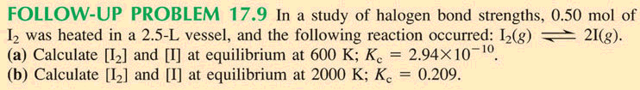
Example
Initial Concentration of I₂: 0.50 mol/2.5L = 0.20 M
I₂ 2 I
More than 3
orders of mag.
between these
numbers. The
simplification will
work here.
Initial
change
equil:
0.20 0
-x +2x
0.20-x 2x
With an equilibrium constant that small, whatever x is, it’s near
dink, and 0.20 minus dink is 0.20 (like a million dollars minus a
nickel is still a million dollars).
0.20 – x is the same as 0.20
x = 3.83 x 10-6 M

Slide 36
Example
Initial Concentration of I₂: 0.50 mol/2.5L = 0.20 M
I₂ 2 I
Initial
change
equil:
0.20 0
-x +2x
0.20-x 2x
These are too close to
each other ...
0.20-x will not be
trivially close to 0.20
here.
Looks like this one has to proceed through the quadratic ...
Notes:
I2= 0.12 / I = 0.16

Slide 37
[C][D]
[E][F]
A + B C + D
K₁
K₁ =
K₂ =
[A][B]
[C][D]
C + D E + F
K₂
[E][F]
A + B E + F
K_{c}
K_{c} =
[A][B]
K₁
K_{c} =
x
K₂
If a reaction can be expressed as the sum of two or more reactions, the equilibrium constant for the overall reaction is given by the product of the equilibrium constants of the individual reactions.
14.2

Slide 38
If a change is imposed on a system at equilibrium, the position of the equilibrium will shift in a direction that tends to reduce that change.

Slide 39
Effects of Changes on the System
Concentration: The system will shift away from the added component. If a component is removed, the opposite effect occurs.
2. Temperature: K will change depending upon the temperature (endothermic – energy is a reactant; exothermic – energy is a product).

Slide 40
Effects of Changes on the System
Pressure:
  The system will shift away from the added gaseous component (most moles of GAS). If a component is removed, the opposite effect occurs.
  Addition of inert gas does not affect the equilibrium position.
  Decreasing the volume increases the pressure, which shifts the equilibrium toward the side with fewer moles of gas.

Slide 41
Le Châtelier’s Principle
Changes in Concentration continued
Remove
Remove
Add
Add
aA + bB cC + dD
Change
Shifts the Equilibrium
Increase concentration of product(s)
left
Decrease concentration of product(s)
right
Increase concentration of reactant(s)
right
Decrease concentration of reactant(s)
left
14.5

Slide 42


Slide 43

Equilibrium Decomposition of N₂O₄

Slide 44
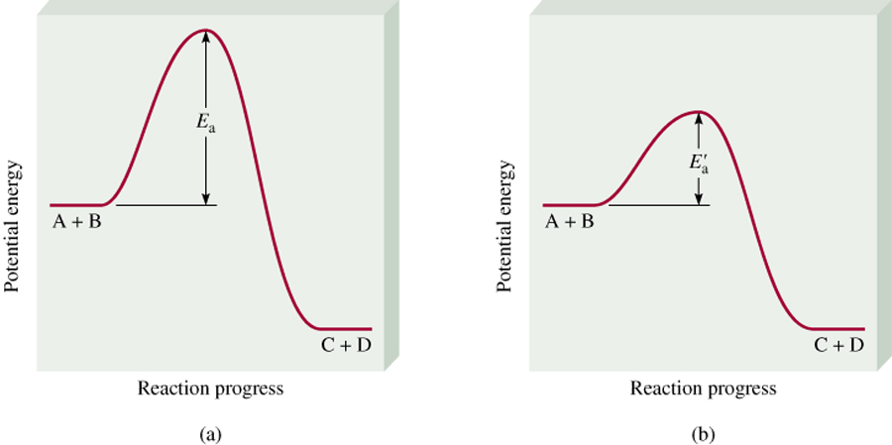
Le Châtelier’s Principle
Adding a Catalyst
  does not change K
  does not shift the position of an equilibrium system
  system will reach equilibrium sooner
uncatalyzed
catalyzed
Catalyst lowers E_{a} for both forward and reverse reactions.
Catalyst does not change equilibrium constant or shift equilibrium.
14.5

Slide 45
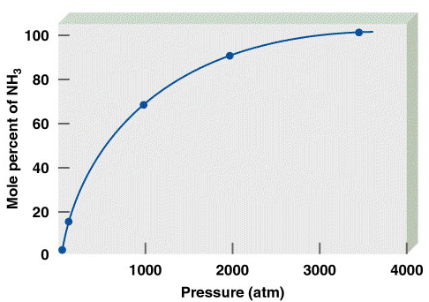
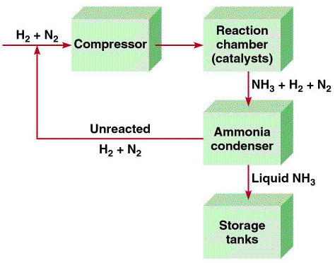
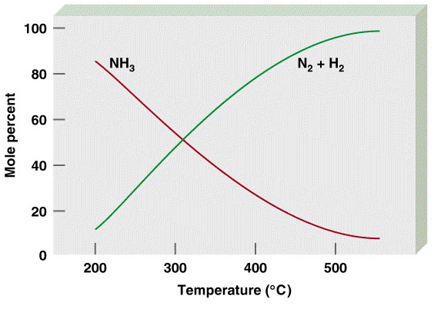
Chemistry In Action: The Haber Process
N₂ (g) + 3H₂ (g) 2NH₃ (g) ΔH0 = -92.6 kJ/mol

Slide 46
Le Châtelier’s Principle
Change Equilibrium
Constant
Change
Shift Equilibrium
Concentration
yes
no
Pressure
yes
no
Volume
yes
no
Temperature
yes
yes
Catalyst
no
no
14.5

